Slide 1
Project 1 - Team 2
Determining factors of movie critical acclaim over the past 10 years
Juliet Messier, Michéal McCloskey, Stacie Sauer-Rackham, Seren Frazin, Judith Cuellar

Slide 2

Agenda
Problem Statement & Limitations
Determining Factors
Net Revenue / Gross Revenue
Genre
Audience Approval
Intended Audience
Film Director
Final Analysis

Slide 3
Problem Statement
For our project, we will use movie data from the last 10 years to uncover determining factors in movie critical acclaim.
Each team member will be searching for and presenting possible correlations that may contribute to high critical acclaim.
After analyzing our findings, we will review the biggest takeaways.

Slide 4
Limitations
Things to Consider:
Critical Acclaim is considered a movie with a rating of over 7.0
This dataset is only representative of 2 data sets from free APIs
The data was limited to only a 10 year span of time
Movie ratings are a subjective value

Slide 5
Gross Revenue & Net Revenue

Slide 6
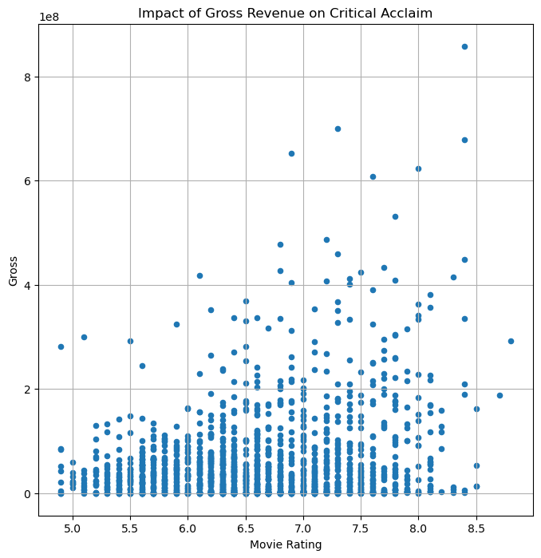
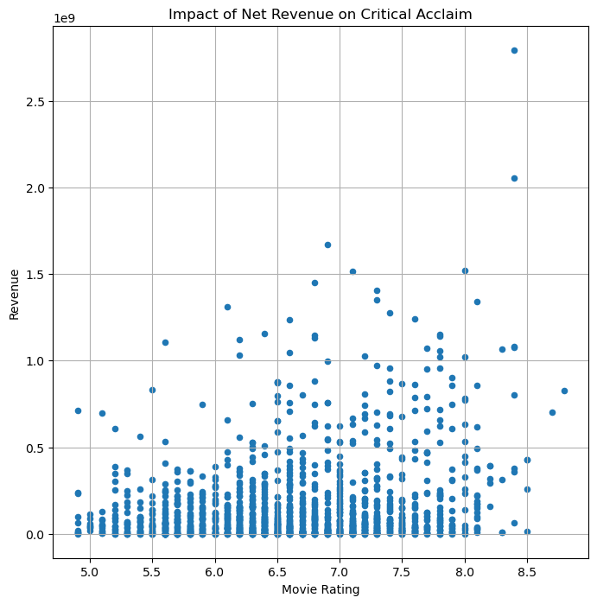
Net Revenue / Gross Revenue

Slide 7
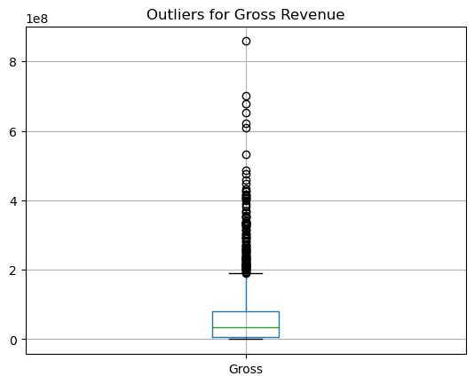
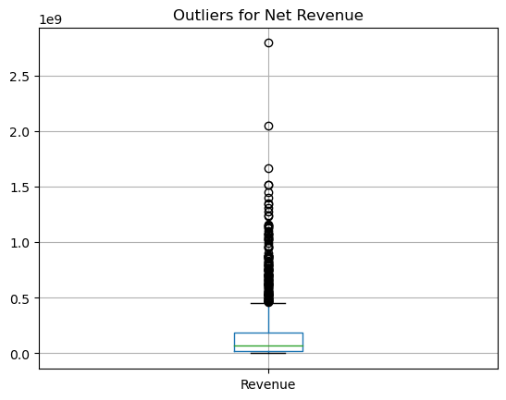
Net Revenue / Gross Revenue Outliers

Slide 8
Highest grossing movie

Slide 9
Genre

Slide 10
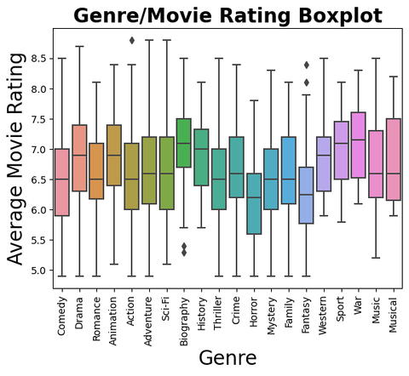
Genre
From 2010-2020, there was minimal variance in movie ratings across 20 genres

Slide 11
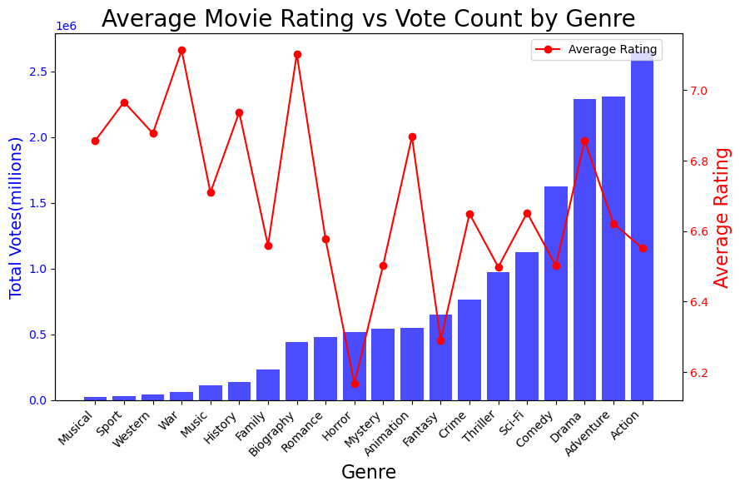
Genre
Genres with most votes don't win ratings race

Slide 12
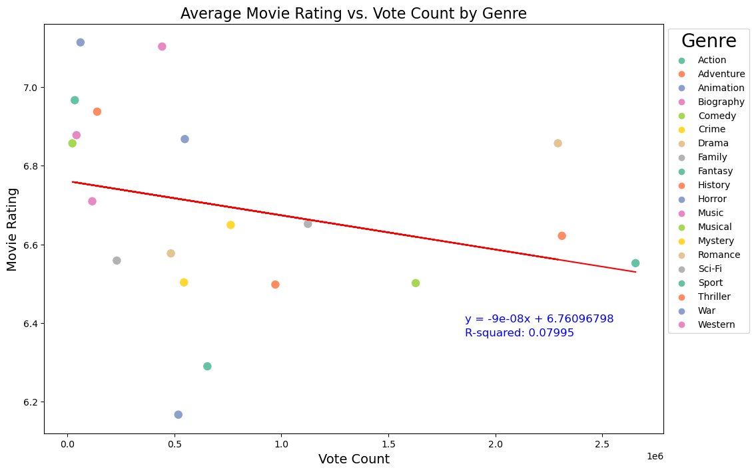
Genre
Movie popularity barely affects rating

Slide 13
Audience Approval

Slide 14
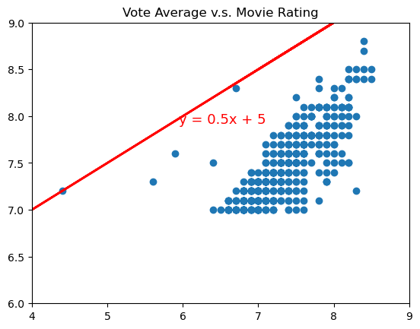
Audience Approval

Slide 15
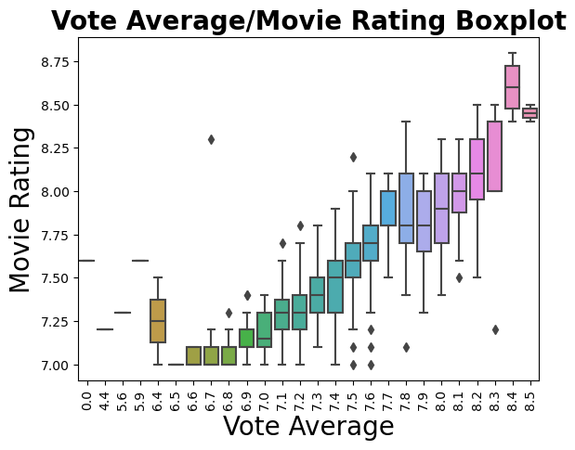
Audience Approval

Slide 16
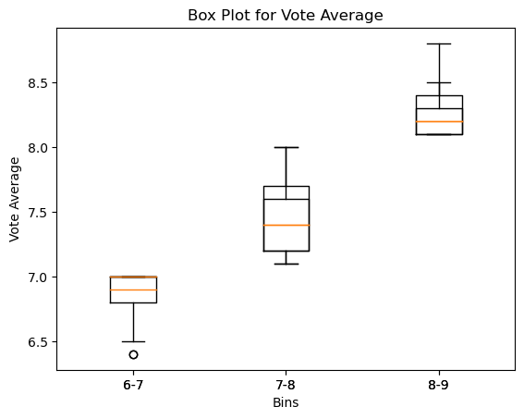
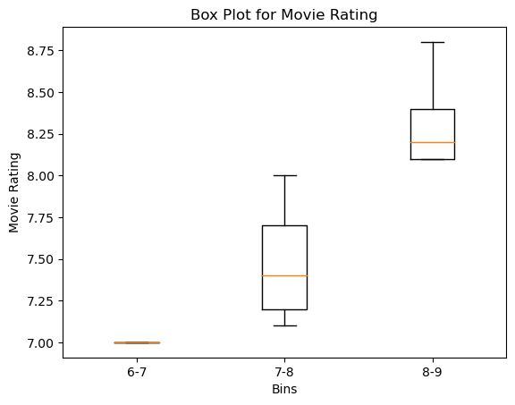
Audience Approval

Slide 17

Audience’s Favorite Film Your Name.

Slide 18
Intended Audience

Slide 19
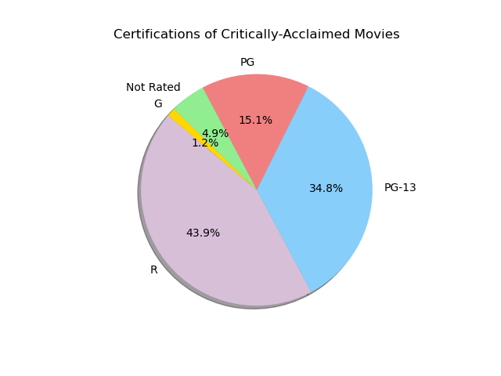
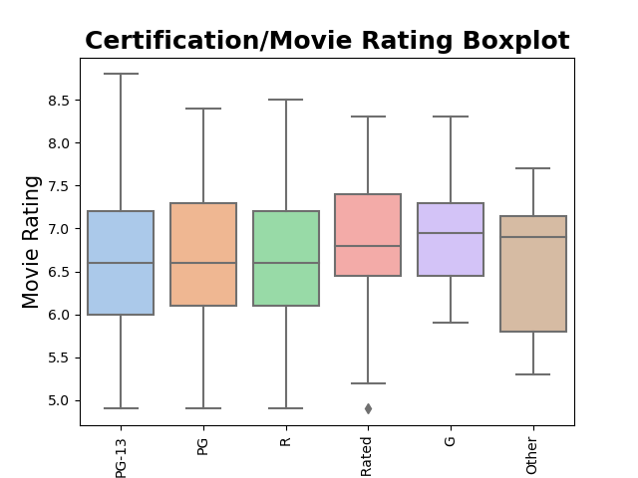
Intended Audience

Slide 20
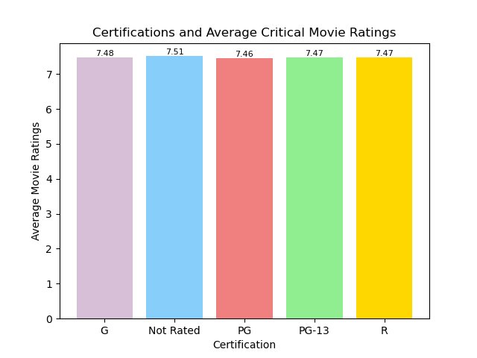
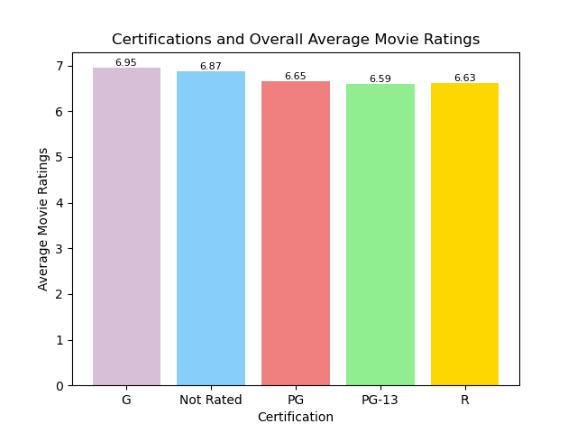
Intended Audience

Slide 21
Highest Rated PG Movie Spider-man: Into the Spider-verse

Slide 22
Film Director

Slide 23
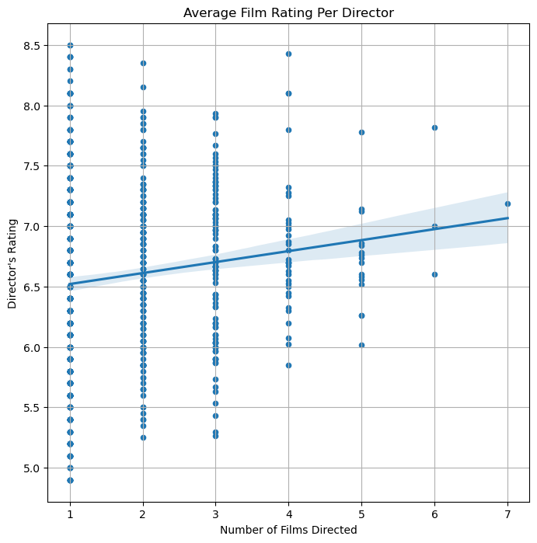
Film Director

Slide 24
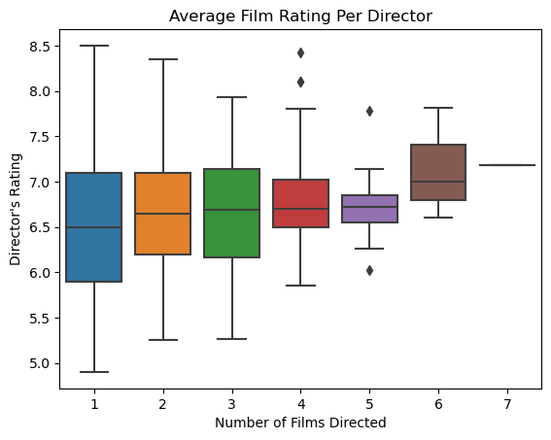
Film Director

Slide 25

Steven Speilberg

Slide 26
Final Analysis
Lack of strong correlations in expected data.
Our data showed a weak correlation for both net revenue and gross revenue
Less reviewed movies tend to have higher ratings!
The results for movie ratings from audience members had a positive correlation to the rating that the movie received from critics. As movie goers rated a movie higher, critics tended to as well.
The results for audience ratings indicated relatively similar scores, meaning that regardless of certification, there was no clear indicator that one certification did any better than the rest in terms of movie rating.
According to our data directors are not an indicator for a high critical acclaim rating.

Slide 27
Top Rated Movie Inception

Slide 28
Worst Rated Movie (Mudit’s Favorite!) Breaking Dawn Part 1

Slide 29

*Not really, see you tomorrow!

